Slide 1
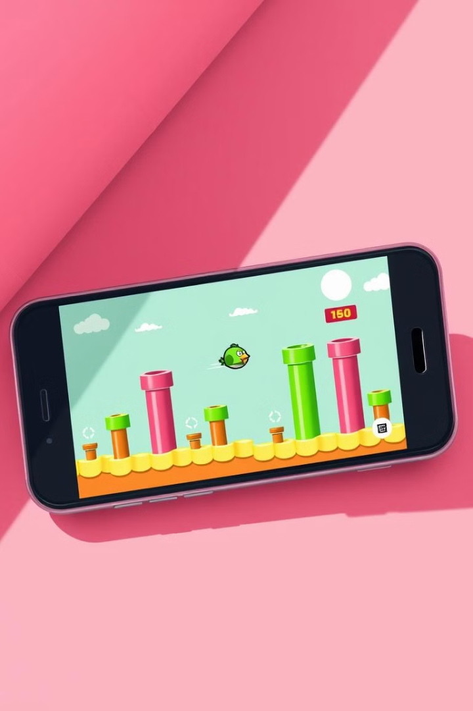
Flappy Bird: A Kivy Python Game Project
This presentation explores the development of a classic mobile game, Flappy Bird, using the Python-based Kivy framework.

Slide 2
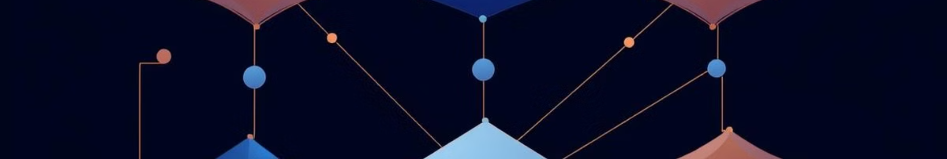
Introduction to Object-Oriented Programming (OOP)
Encapsulation
Inheritance
Bundles data and methods into a single unit (class) to improve organization and security.
Allows classes to inherit attributes and methods from other classes, promoting code reuse.
Polymorphism
Abstraction
Enables objects to be treated as instances of their parent class, increasing flexibility.
Hides complex implementation details, providing a simplified interface for ease of use.

Slide 3
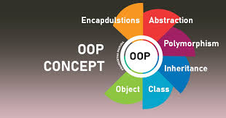



Implementing OOP Concepts in Flappy Bird
Game Classes
Inheritance
Create classes for Game, Bird, Pipe, and Score to organize gameplay logic.
Design a base Obstacle class inherited by Pipe and Rock obstacles.
Polymorphism
Use a list of Obstacle objects to handle different types uniformly.

Slide 4
Introduction to Kivy: A Python Library for Multi-Touch Applications
Cross-Platform Compatibility
Multi-Touch Support
Kivy enables the creation of apps that seamlessly run across various platforms, including Windows, macOS, Linux, Android, and iOS.
Kivy natively supports multi-touch gestures, making it ideal for developing interactive and engaging mobile games.

Slide 5
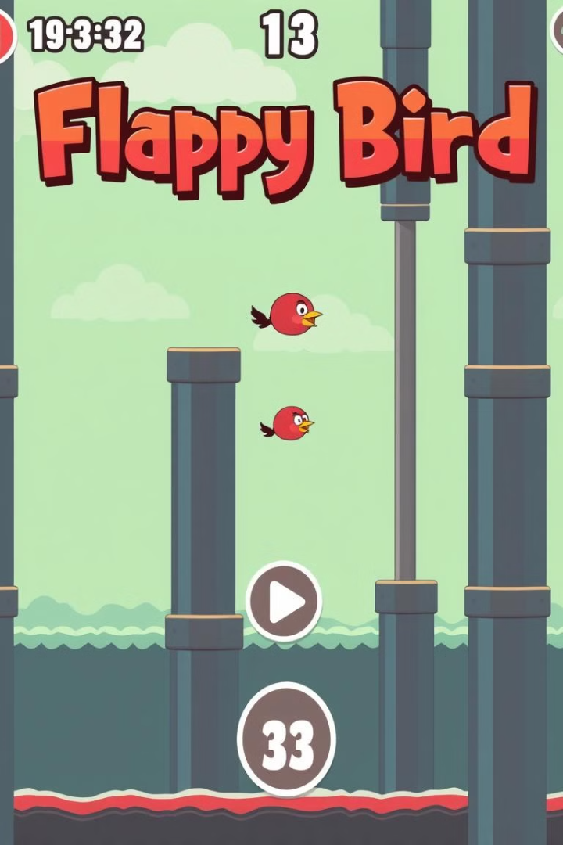
Designing the Game's User Interface
Game Background
Game Bird
A simple, repeating background, either sky or night.
A sprite representing the bird, with animations for flapping and falling.
Game Pipes
Score Display
Obstacles the bird must navigate through, appearing in random heights and speeds.
A counter to track the player's score, updated as the bird passes through pipes.

Slide 6
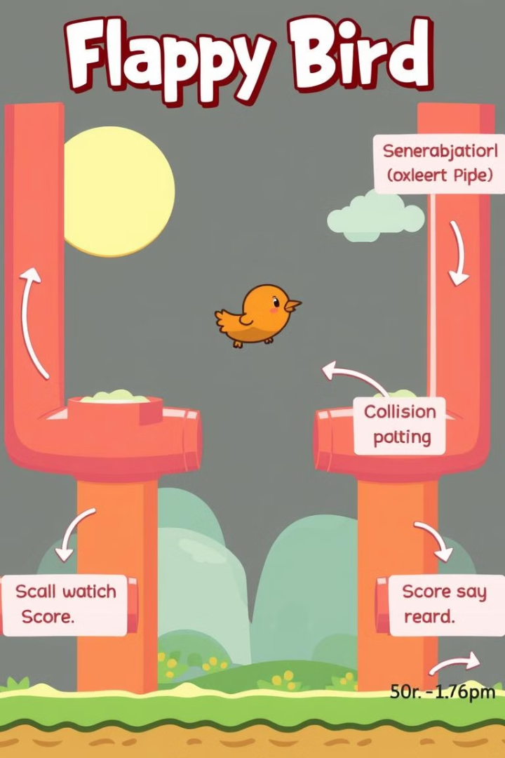
Implementing Game Logic and Mechanics
1
Bird Movement: Implementing physics to control the bird's flapping and descent.
2
Pipe Generation: Creating and positioning pipes dynamically, increasing difficulty over time.
3
Collision Detection: Detecting collisions between the bird and pipes, ending the game.
4
Score Calculation: Incrementing the score when the bird passes through pipes.

Slide 7
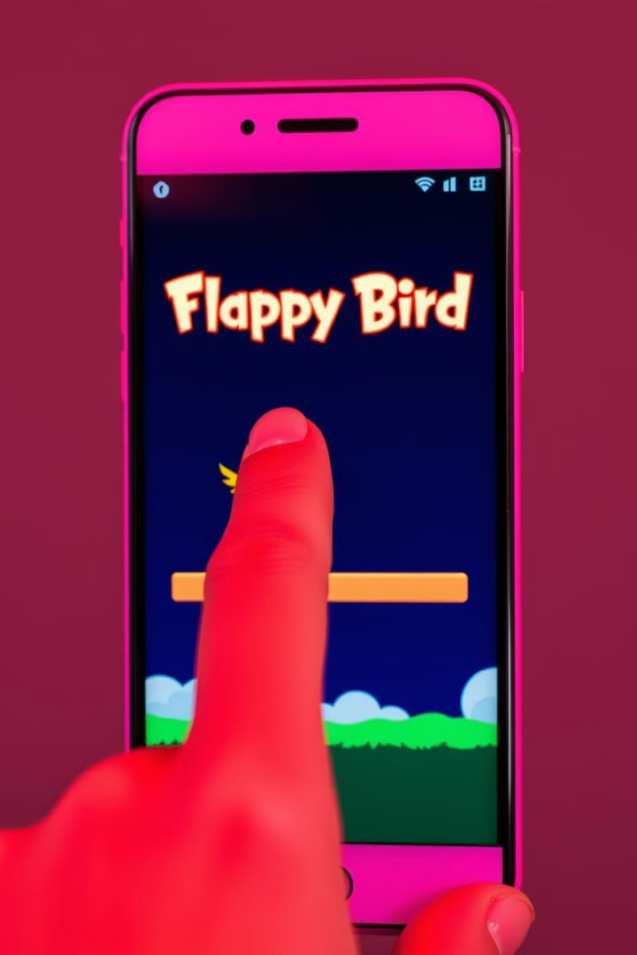

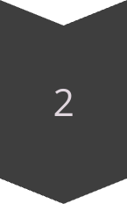
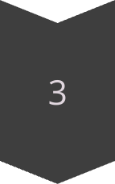
Handling User Interactions and Input
Touch Input: Capturing touch events on the screen to control the bird's flapping.
Jump Mechanics: Implementing a jump action for the bird based on touch input.
Game Restart: Allowing the player to restart the game after a collision.

Slide 8
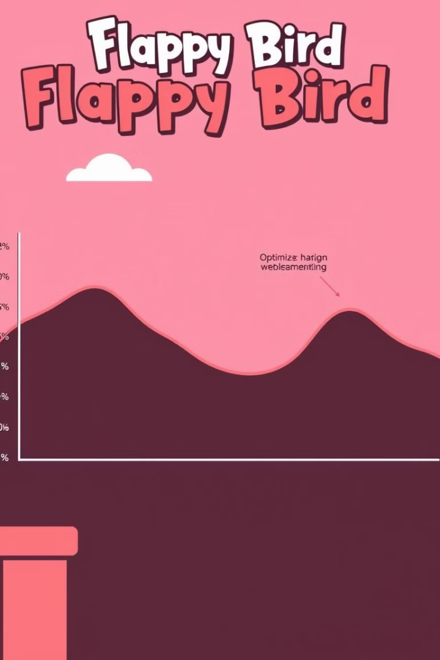



Optimizing Performance and Efficiency
Sprite Optimization
Code Optimization
Using lightweight sprites and minimizing the number of draw calls.
Refactoring code to improve efficiency and reduce computational overhead.
Memory Management
Optimizing memory usage to prevent performance bottlenecks.

Slide 9
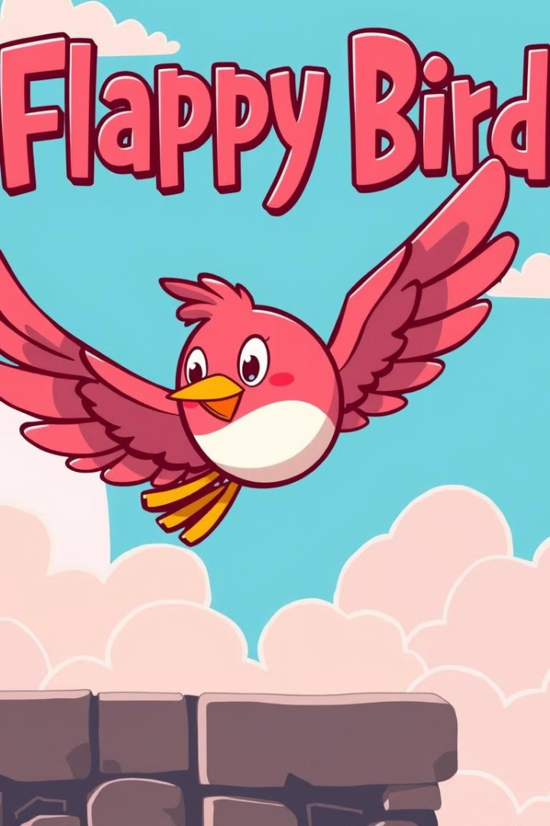
Integrating Sound Effects and Music
1
2
Sound Effects
Background Music
Adding sound effects for bird flapping, collisions, and scoring.
Implementing catchy background music to enhance the game's atmosphere.

